Slide 1


GROW GREEN
By :
Pratham Shah IU2041051095 Saad Kadri IU2041051092 Meet Vachhani IU1941050079

Slide 2

ABSTRACT
Now a days we are facing problem of global warming day by the temperature is increasing because of cutting of trees. There is big problem of cutting of tress for their own benefit. Now a days no one is aware to grow more plants. They want tools seeds everything for growing plant and now a day’s peoples are so busy that they have no such time to buy the equipment’s and grow trees. So to overcome with this problem we are developing a website. From which user has just to
register and then log on to the website.

Slide 3
ABSTRACT
After doing so the user can simply request for plantation from the given trees list. After that user has not to worry for plantation that will be our job to plant the seed for the requested plant at users decided location. After our job there’s only user job to take care of the plant which has been planted. The user can also buy fertilizers and tools required for plant maintained from using our website. It will make user effort less and there is also possibility of growing more trees and to
overcome the environmental problems.

Slide 4

We are going to develop a web based application.
Introduction of the Systems
Our website can be used for requesting the plantation of trees.
The user can request for the plants to be planted from the given list.

Slide 5
PROPOSED SYSTEM
Currently we are facing some environmental problems now a days.
Trees are the better option to avoid the pollution.
So to overcome this problem we are developing the system related to the trees plantation and to take care of the planted trees.
By using this system the efforts of the user to plant trees and to buy seeds
will be reduced.

Slide 6


FEATURES
ACTIVITY DETAILS
PLANTATION
FERTILIZERS
SOIL TEST
PLANT HEALTH MONITORING
Tools

Slide 7

Hardware Requirements:
RAM: 4 GB
Hard Drive Storage needed: 10 GB Other Hardware requirements: No
Platform
Supported Operating System: Window XP and above.
Framework
Markup Language: HTMLS Programming Language: PHP 7.3.9 Scripting Language: Java
Technical Specification
Front-End: HTML5, CSS 3
Back-End: ASP.net 2017, SQL 5.7.23
IDE: ASP.net 2017
UML Tools: Microsoft Visio 2010 Professional Version. SRS Tools: Microsoft Word 2019 Professional Plus Version.
HARDWARE SPECIFICATION

Slide 8

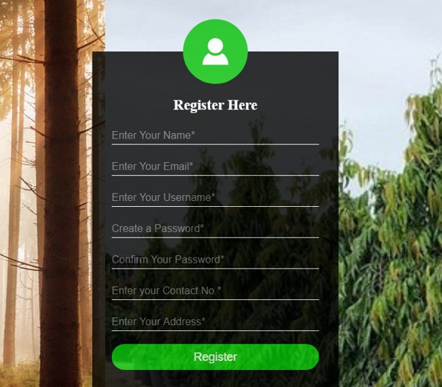
REGISTRATION PAGE

Slide 9

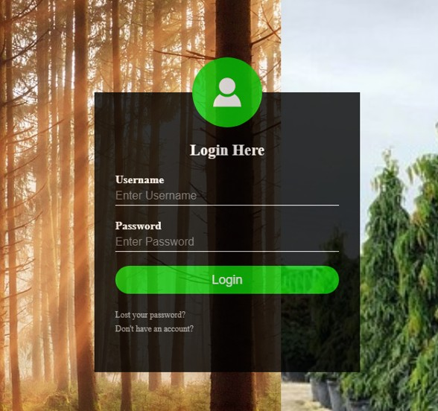
LOGIN PAGE

Slide 10


THANK YOU

